Slide 1
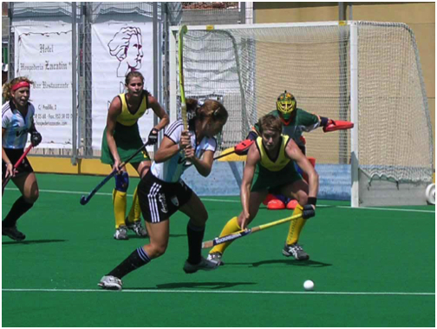
The hockey stick is at 90° before she takes the shot.
The hockey sticks starts at 320° before she lifts it up at 90° before swinging it at the ball and ends at 125°.
Her hips turn and follow the ball as she hits it.

