Slide 1
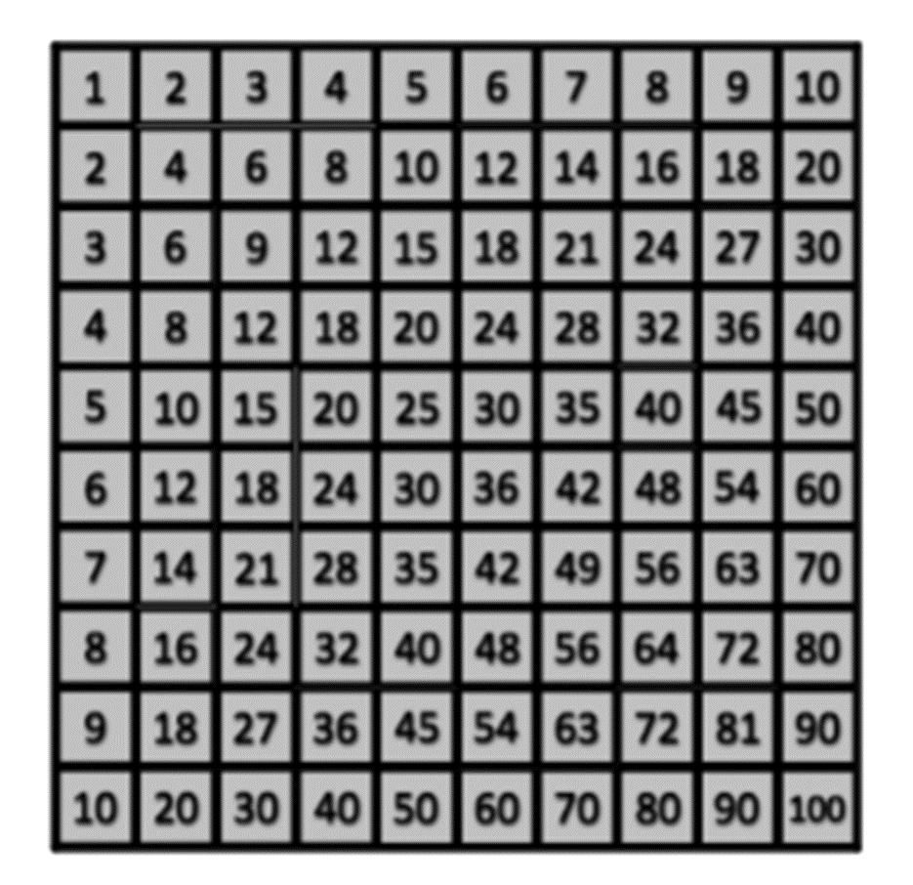
Step-by-step solution to Multiplication Square Jigsaw

Slide 2
