Slide 1
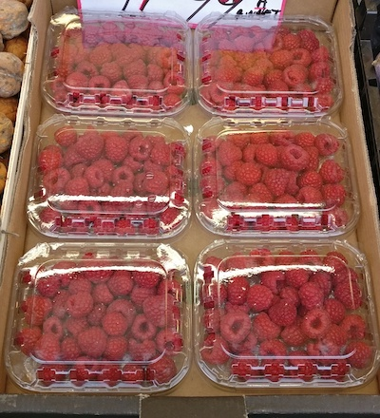

Slide 3
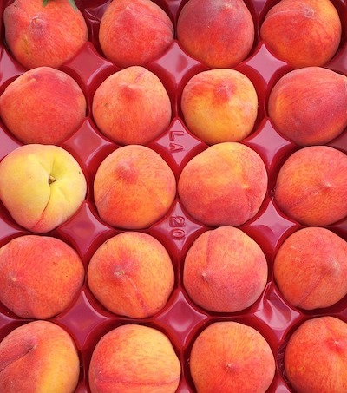
4
X
5
=
20
Here are some peaches . There are 4 in the top row and 5 down the side.
There are 20 oranges.

Slide 4
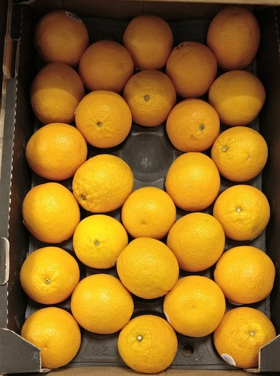
3
+3
+3
+3
+3
=
15
2
+2
+2
+2
+2
+2
=
12
Here are some oranges . There are 3 in the top row , then 2, then 3 , then 2, then 2, then 2 , then 3 , 2,3, 2 , 3.
15
+12
=
27
There are 27 oranges.

Slide 5
This question is asking you How Many raspberries there are in the boxes. There are approximately 37 raspberries in each box and there are 6 boxes. 6x37=222. There are around 222 raspberries.

