Slide 1
As you can see above the number of rectangles changes by 2 then by 3 then by 4 then by 5
Number of segments
1 | 2 | 3 | 4 | 5 | 6
1 | 3 | 6 | 10 | 15 | 21
Number of rectangles
+2
+3
+4
+5
+6
But that’s not to important when you're making an nth term, what important is the difference between n(number of segments) and nth(number of rectangles ) in this it increases by 0.5, 1x 1= 1, 2x 1.5=3,3x 2 = 6, 4x2.5=10,5x3=15,ect
The hard thing is to find an algorithm and not a pattern

Slide 2
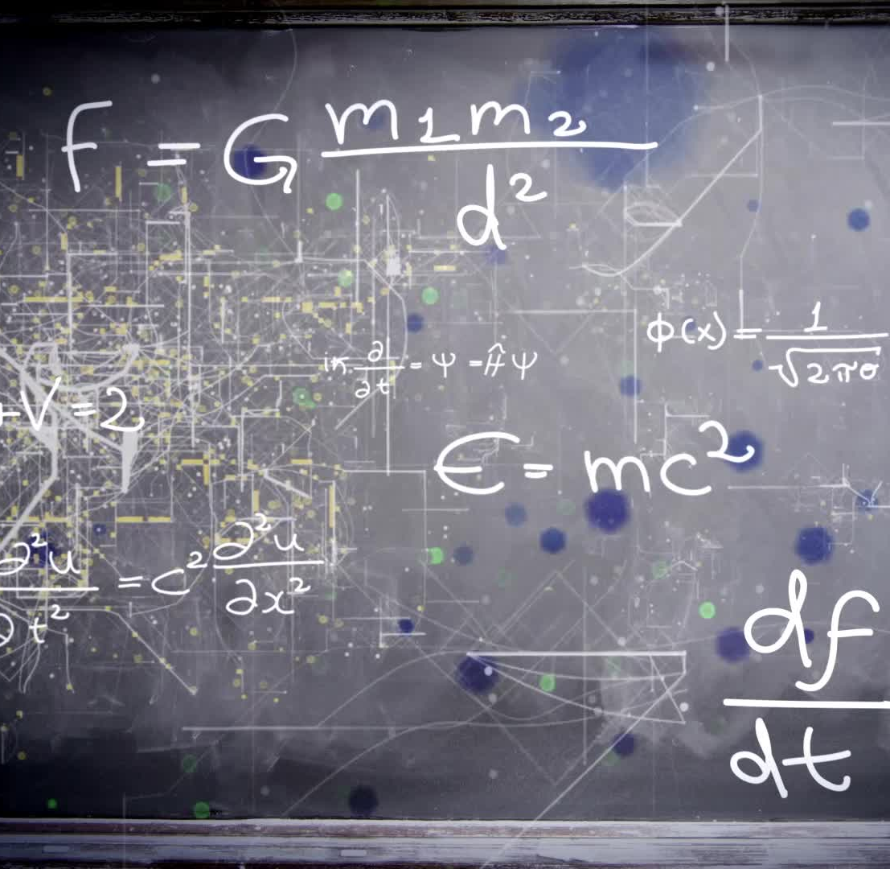
My algorithm
Nth = n *(n / 2+0.5)

