Slide 1
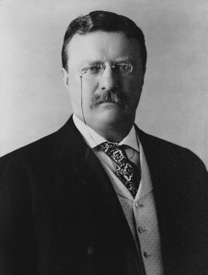
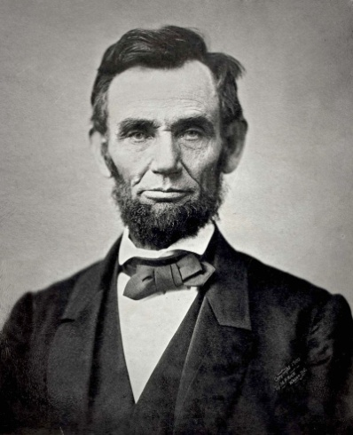
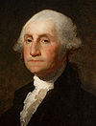
Hypotheses
Roosevelt
we predict that the presidents now get older because there is more health services and less disease
Washington
Lincoln

Slide 2
Stem & Leaf Diagram to show age of death for American presidents
6 9
3 6 7 7 8
0 0 3 3 4 4 5 7 7 7 7 8
0 1 1 2 3 4 7 8 9
0 1 3 5 8 8
0 0 3 3

Slide 3

Age of Death
100/44 = $\frac{25}{\begin{aligned}11 \\ \end{aligned}}$
Number of presidents in category * $\frac{25}{11}$
= the % out of 100
As shown in the stem and leaf diagram we have categorised the American presidents into age of death ; e.g. 60’s and 70’s.
There are 44 American Presidents:
(rounded to the nearest two decimal places) 27.27% died in their 60’s
09.09% died in their 90’s
13.63% died in their 80’s
20.45% died in their 70’s
11.36% died in their 50’s
04.54% died in their 40’s
11.36% are still present

Slide 4
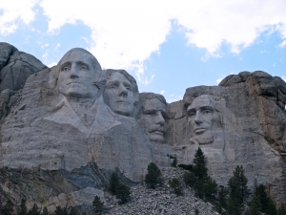
Reason of Death
100/44 = $\frac{25}{\begin{aligned}11 \\ \end{aligned}}$
Different deaths in categories * $\frac{25}{11}$
= the % out of 100
These are the percentages of the American Presidents cause of Death: (rounded to the nearest two decimal places)
11.36% died because of illness
06.81% died because of old age 25% died because of disease 27.27% died because of either a stroke, heart or respiratory failure 09.09% died were assassinated 06.81% died because of blood clot or internal bleeding 11.36% are still present

Slide 5
Age of becoming President
Every President was elected between the age of 42 and 69
Washington – 57
Adams -61
Jefferson - 58
Madison - 57
Monroe - 58
Quincy Adams – 57 Jackson -62
Van Buren - 54
Harrison - 68
Tyler - 51
Polk - 49
Taylor - 64
Fillmore - 50
Pierce - 48
Buchanan -65
Lincoln – 52
Jonson – 57
Grant – 46
Hayes – 54
Garfield – 49
Arthur – 51
Cleveland – 47
Harrison – 55
McKinley – 54
Roosevelt – 42
Taft – 51
Wilson – 56
Harding - 55
Coolidge – 51
Hoover – 54
F Roosevelt – 51
Truman – 60
Eisenhower – 62
Kennedy – 43
Johnson – 55
Nixon – 56
Ford – 61
Carter – 52
Reagan – 69
W Bush – 64
Clinton - 46
Bush - 54
Obama - 47

Slide 6
Stem & Leaf Diagram to show age of election for American presidents
2 3 6 6 7 8 9
0 1 1 1 1 1 2 2 4 4 4 4 5 5 5 6 7 7 7 7 8
0 1 1 2 2 4 4 5 8 9

