Slide 1


The Millennium Mathematics project
nrich.maths.org
plus.maths.org
Rich mathematical problems to do
Mathematical articles to read and do
Help and advice forum
Mathematical articles
Podcasts
Careers

Slide 2
Main places to know about
NRICH nrich.maths.org
PLUS plus.maths.org
stemNRICH nrich.maths.org/stemadvanced
Ask NRICH nrich.maths.org/discus
University nrich.maths.org/university

Slide 3
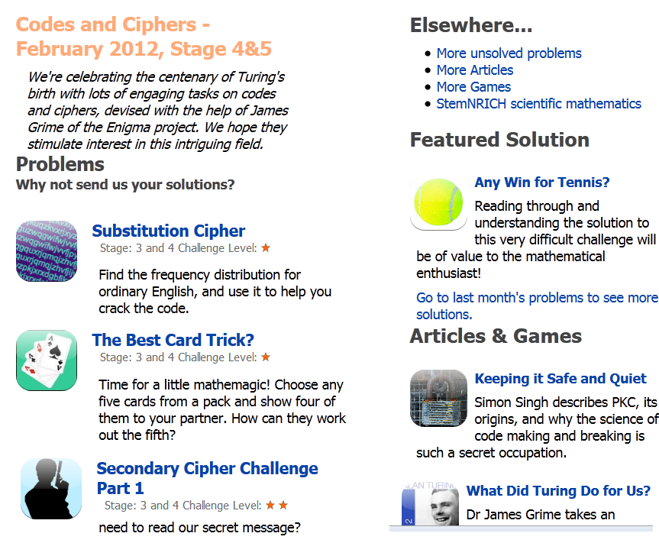
NRICH

Slide 4
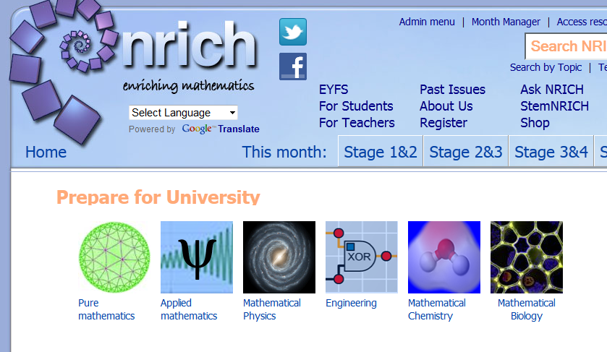
University pages

Slide 5
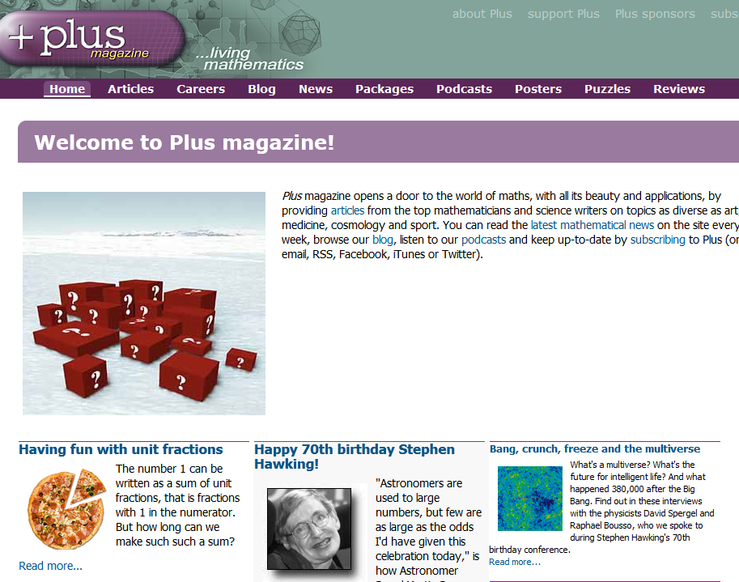
Plus
plus.maths.org

Slide 6
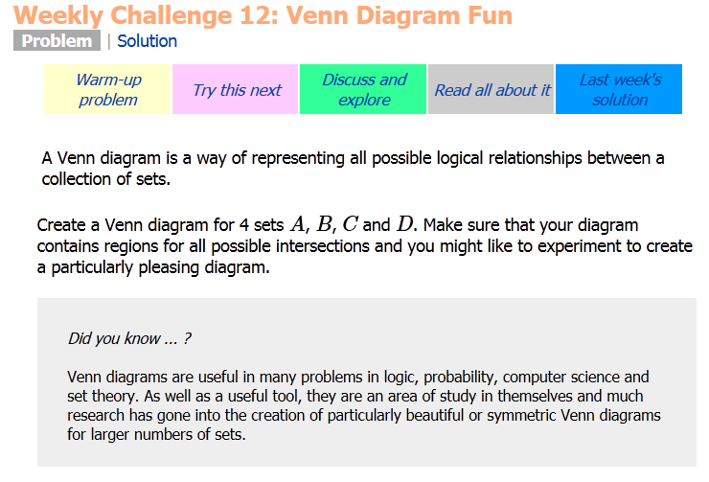
A sample problem

Slide 7

stemNRICH

Slide 8
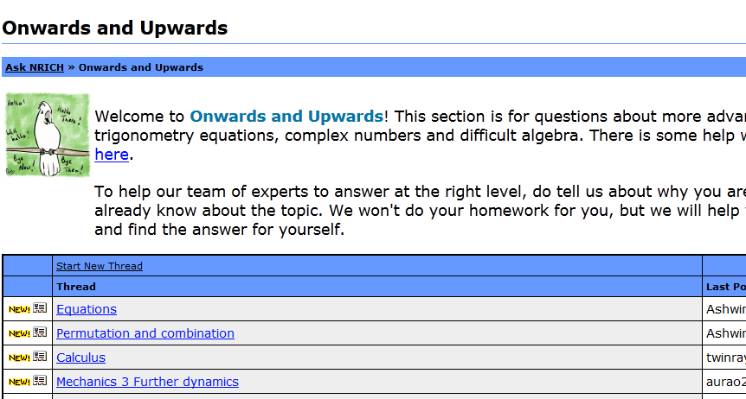
Ask NRICH

Slide 9
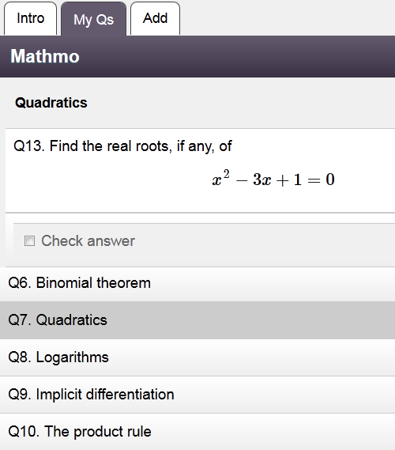
Mathmo

