Slide 1
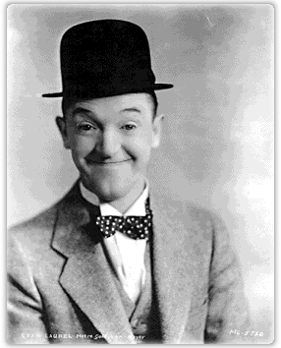

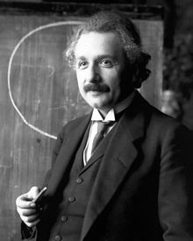
Dyspraxia and doing mathematics

Slide 2

Dyspraxia is ...
a specific learning difficulty that affects the brain's ability to plan sequences of movement.
a condition which leads to many varied difficulties
often not taken seriously
seriously affects success in mathematics

Slide 3
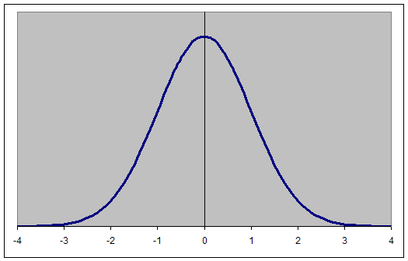
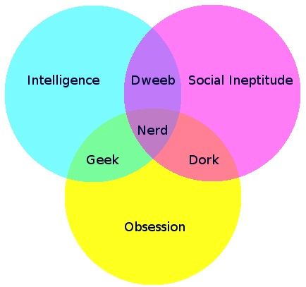

Normality, whatever that is
Normal
Not normal
Different
Weird
Eccentric etc.
An old-fashioned analysis of diversity

Slide 4
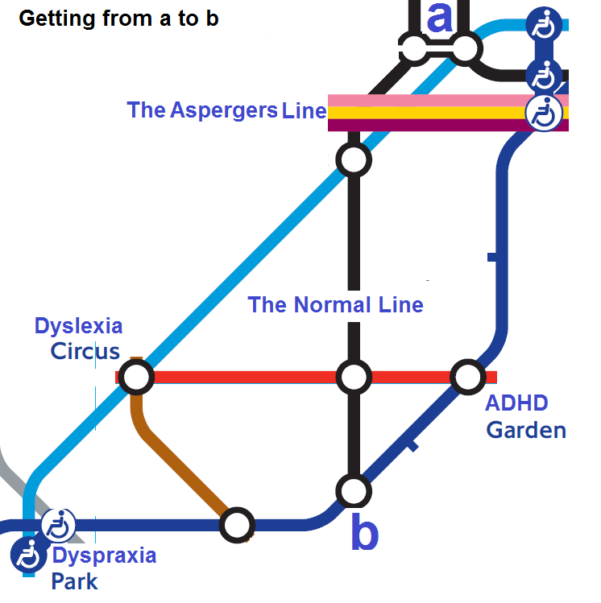
Neuro-diversity – different ways of thinking
Dyspraxia
Dyslexia
Dyscalculia
ADHD
Autism
Tourettes

Slide 5
Hell is severe problems with ...
ISSUE | SCHOOL/MATHS PROBLEMS
Gross motor skill | Clumsy; uncoordinated; poor posture; fatigue; problems using equipment
Reading and writing skills | Untidy writing; Incomplete sentences; Frequent ‘careless’ mistakes; Reversing digits; Misreading questions
Spacetime skills | Frequently lost, disorientated or late
Visual problems | Trouble keeping place reading/reading from tables; poor relocating board to paper; errors copying
Memory and attention span | Poor attention span; Poor short term memory; Difficulty remembering details
Oral problems | Unclear speech; take time to organise thoughts
Over-sensitive to touch or sound | Can’t shut out noise; Can’t concentrate in groups; Easily distracted; Easily overloaded; Often uncomfortable
Cognition | Difficulty executing a method; Difficulty planning; must understand principles. At risk of poor self-esteem.

Slide 6
Heaven is unusually good ..
ISSUE | SCHOOL/MATHS BENEFITS
Creative and original thinking | ???
Good problem solving skills | ???
Good strategic thinking | ???
Highly motivated and determined | Will work towards a goal
Individuality | ???

Slide 7
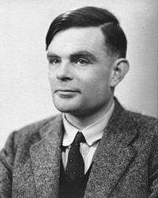



Some errors of the past
Forcing left-handed people to write with their right hands.
Forcing homosexual people to ‘conform’.
Forcing dyslexics to learn their tables by rote.
Repeatedly punishing those who struggle to fit in with traditional schooling.

Slide 8
Key teaching suggestions -
Remember that students might be
  Distracted
  Feeling tired or uncomfortable
  Confused
  Overloaded
  Flustered, disorganised and forgetful
Give clear handouts.
Give time to frame and answer questions.
Allow students to take regular breaks.
Encourage students, emphasising strengths.
Be patient; avoid making assumptions about IQ.
Remember that your way might not be their way.

